Slide 1

BUAN 6356 – Business Analytics with R Group Project: Used Car Price Prediction
Group 8
Melissa Cunningham
Sudhindra Patri
Vivek Shrimali
Aralyn Tran

Slide 2




Introduction
Auto Industry accounts for 3% of GDP of United States . McKinsey’s auto retail micro-market model estimates that Americans buy 39.4 M used cars each year, versus 17.3 M new ones (as per 2018)
So, What’s the pain point?
Need for effective used car price prediction system to determine the worthiness of the car using a variety of features. It is important to know their actual market value while both buying and selling, thereby helping for both dealers and consumers
User Story :
Vivek had a plan to purchase a used car. He needs to understand the dynamics of market and worthiness of car

Slide 3

Data Description & Pre-processing
Data source : Kaggle (scrapped from Craigslist)
Data : It contains relevant information including columns like price, year, odometer, manufacturer, condition, cylinders, fuel, transmission, drive, size, type, paint color and other categories.
Data Cleansing steps:
Removed URL and unnecessary description columns
Removed the first 27 NULL records in the dataset
Filtering high- priced and low-priced cars
Price limited to range $1,000 to $500,000
Filtering car odometer to defined range greater than 0 and less than 300,000 miles
Looking for duplicate records
Cleaning manufacturers info for missing records
Combined few independent records of cars to similar groups to reduce predictor variables. For example, we combined wagon with sedan as the dataset comprised of sedan cars under wagon category.
Combining blank manufactures info to other.
Blank values grouped to other for variables (cylinders, transmission, NA)
Dropped unsignificant variables (paint color, size)

Slide 4

Exploratory Data Analysis
While exploring the data, we looked at the different combinations of features with the help of visuals.
boxplots of extreme outliers

Slide 5
Other Key plots :
correlation plot
plotting vehicles by state
Fun Fact : Majority of cars sold as per dataset are Ford, Chevrolet, Toyota

Slide 6

Empirical Analysis
Applied machine learning models as a framework for the data analysis with a goal to accurately predict the dependent variable, price for future observations
Models Applied with 80-20 split on test and training data:
S.No | Model | RMSE Training | RMSE Validation | Adjusted R²
1 | Linear Regression | 9741.197 | 9805.253 | 58.69%
2 | Ridge Regression | 9741.201 | 9805.26 | 58.44%
3 | Regression Tree | 9984.928 | 10017.02 | 54.60%
4 | Linear Regression with Log Price | 0.4942348 | 0.4920494 | 65.97%

Slide 7
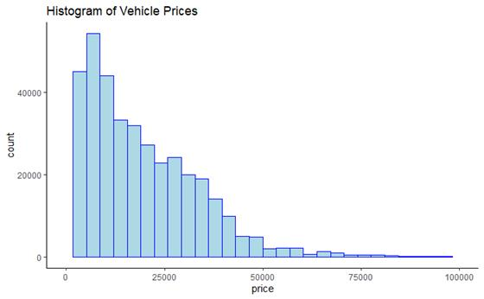
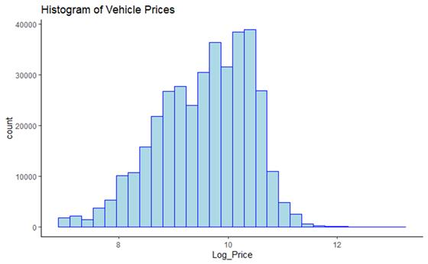
Visual aids
The below graphs explains why log transformation for price is done. Histogram of prices is skewed, whereas histogram of Log Prices is more normally distributed.

Slide 8
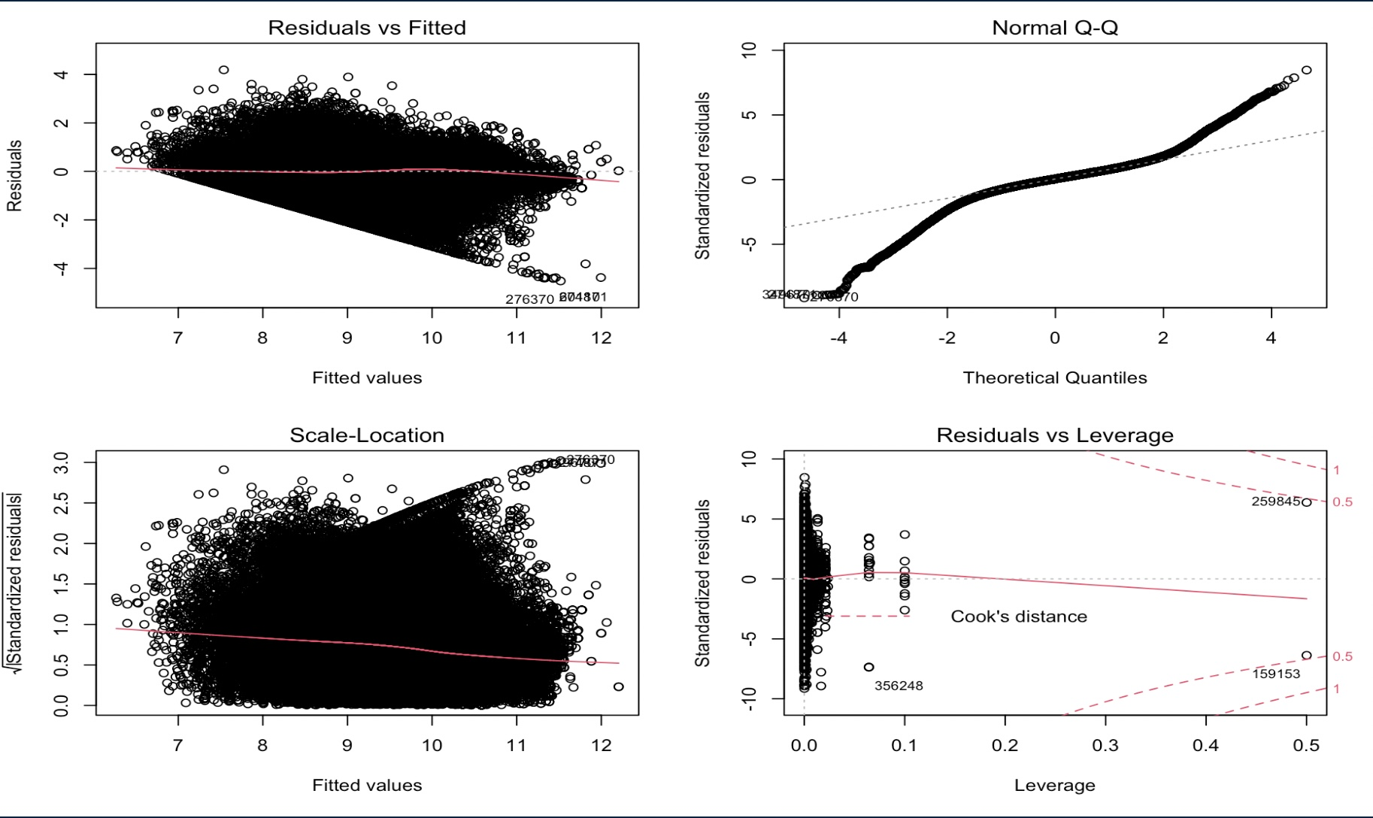
Plotting residuals (assumptions validation)

Slide 9


Results & Conclusion
Model 2 is the best. Taking a log transform significantly reduces the residual distance, R squared is highest and model assumptions are met.
User story :
Yayyyyyy !!
Vivek now have a model to predict car prices before purchasing.
Price Prediction for Hyundai Sonata car : $ 3,660.75
Actual Price: $4,000
Price Prediction for Toyota Prius car: $ 7,453.93
Actual Price: $7,800

